Slide 1
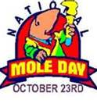


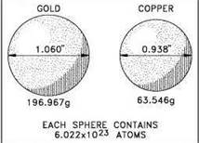
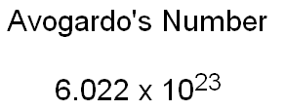
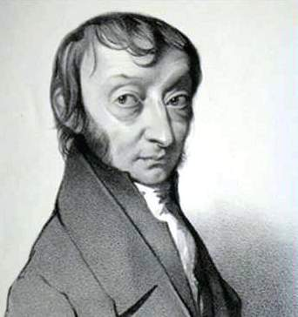
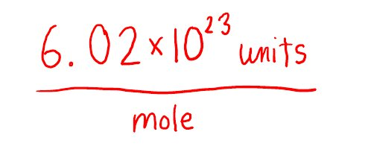
The Mole

Slide 2
How do we measure the amount of a substance?
Matter is made of different kinds of particles.
We count the number of particles of that substance.
Since there are a very large number of particles in any substance, we need to define a unit of measure:
1 mole = 6.02 x 10²³ representative particles of a substance.
That number, which is experimentally determined, is called Avagadro’s number.

Slide 3
Moles Work for Any Type of Bonding
There are various types of arrangements that atoms can take:
Individual atoms (metallic bonding, noble gases)
Formula units or ions (ionic bonding)
Molecules (covalent bonding)

Slide 4
A mole of any atom has 6.02 x 10²³ atoms
A mole of any molecule has 6.02 x 10²³ molecules
A mole of any formula unit has 6.02 x 10²³ formula units
A mole of oranges has 6.02 x 10²³ oranges, etc.

Slide 5
Here is how the International Union of Pure and Applied Chemistry (IUPAC) defines "mole:"
The mole is the amount of substance of a system that contains as many elementary entities as there are atoms in 0.012 kilogram of carbon-12. When the mole is used, the elementary entities must be specified and may be atoms, molecules, ions, electrons, other particles, or specified groups of such particles.

Slide 6
Working with any masses of chemicals
In the laboratory, chemists may
Need a certain amount of a reagent
Isolate a product in chemical reaction
Predict how much product will be produced for the amounts of reactants used.
For all cases, chemists need to calculate the number of atoms, molecules and/or formula units that are involved.

Slide 7
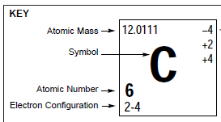
Molar Mass (Gram Atomic Mass)
The IUPAC definition of the mole aligns the measure of “entities” with the relative masses of the elements.
For example:
one mole of carbon = 12.011 g
12.011 g of carbon contains 6.02 x 10²³ atoms
This is called the molar mass (gram atomic mass) of carbon.

Slide 8


Molar Mass (Gram Molecular Mass)
For covalent compounds, you simply add the gram atomic masses of the individual elements to get a mole (6.02 x 10²³ molecules)
For methane (CH₄)
+ 4
12.0111 + 4(1.00794) = 16.0429 g
Molar mass of methane

Slide 9


Molar Mass (Gram Formula Mass)
The mole of an ionic compound is calculated like covalent molecules.
For calcium chloride (CaCl₂)
+ 2
40.08 + 2(35.453) = 110.986 g
molar mass of CaCl₂

Slide 10
Molar Mass Problems
AlCl₃ | TeF₄
Ba(SCN)₂ | NH₄Cl
Fe(OH)₃ | K₂O

Slide 11
SnCrO₄ | (NH₄)₃PO₄
NaHSO₄ | H₂CO₃
Ca(NO₃)₂ | Pb(ClO₂)₂

Slide 12
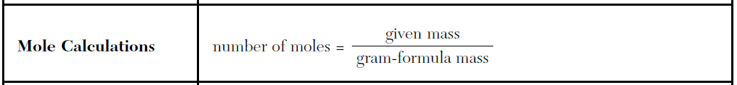
Fractions of moles
In practice, chemists rarely work with exactly one mole. The following equation (Table T) is used:
A mass of a reagent is measured on a balance.
To calculate moles, you have to first calculate the gram formula mass of the compound.
Dividing the mass of the compound by the molar mass (GFM) yields moles.

Slide 13
32.0 grams O₂ | 34.2 grams NH₃
1.00 gram NaCl | 14.0 grams N₂

Slide 14
20.00 grams KOH | 26.0 grams Ca(ClO₄)₂
2.50 grams Cr₂CrO₄ | 24.0 grams CO
50.0 grams KBr | 11.0 grams CO₂
10.0 grams V₂O₅ | 5.08 grams XeF₄

Slide 15
Given Moles, Calculate Grams
When the number of moles is known, it is easy to calculate the given mass by cross multiplication once the molar mass is known.

Slide 16
0.53 moles AlCl₃ | 1.02 moles TeF₄
54.0 moles Ba(SCN)₂ | 0.20 moles NH₄Cl

Slide 17
0.66 moles Fe(OH)₃ | 1.15 moles K₂O
0.213 moles SnCrO₄ | 1.35 moles (NH₄)₃PO₄
4.5 moles NaHSO₄ | 0.003 moles H₂CO₃
3.3 moles Ca(NO₃)₂ | 0.05 moles Pb(ClO₂)₂

Slide 18
Mole-Mole Conversions
Often chemists need to predict how much product will form with a given amount of reactants
Alternatively, a chemist might need to know how much of a reactant is needed to make a certain amount of product.
Using the chemical coefficients in the balanced equation, it is easy to calculate moles of anything.

Slide 19
Given the following reaction:
2H₂ + O₂ 🡪 2H₂O
How many moles of water are produced when 5.00 moles of oxygen are used?
Set up a simple ratio:
5.00 mol O₂* 2 mol H₂O = 10.0 mol H₂O
1 mol O₂

Slide 20
2H₂ + O₂ 🡪 2H₂O
If 3.00 moles of water are produced, how many moles of oxygen must be consumed?
Given the data in problem b), how many moles of hydrogen must be used?

Slide 21
2C₂H₆ + 7O₂ 🡪 4CO₂ + 6H₂O
How many moles of water will be produced from the complete combustion of 3.0 moles of ethane?
How many moles of ethane are needed to produce 6.5 moles of carbon dioxide?

Slide 22
4Al + 3O_{2­} 🡪 2Al₂O₃
What is the minimum number of moles of oxygen gas required to produce 1.00 mol of aluminum oxide?
How many moles of aluminum are needed to produce 4.3 moles of aluminum oxide?

Slide 23
4Al + 3O_{2­} 🡪 2Al₂O₃
You need to make 1 kg of aluminum oxide. How much aluminum and oxygen (in grams) do you need?

Slide 24
Ca + 2H₂O 🡪 Ca(OH)₂ + H₂
how many moles of water are required to react with 3.3 moles of calcium?
how many grams of water are required to react with 3.3 moles of calcium?

Slide 25
Ca + 2H₂O 🡪 Ca(OH)₂ + H₂
How much hydrogen (in moles, and grams) is produced when 20 grams of calcium are placed in a beaker of water?

